Slide 1
Python Basics
Meryl Brodsky, Communication & Information Librarian
Karina Sánchez, Digital Scholarship Librarian
January 7, 2026
https://bit.ly/4pcNvQn for these slides
Notes:
Hi. I am Meryl Brodsky. I am a liaison librarian here at UT Libraries.
Today I’ll be presenting with Karina Sanchez, the Scholars Lab Librarian.

Slide 2
Welcome
Itinerary for the day
1:00 - Welcome and introductory slides
Instruction
1:10 - Google Colab introduction + basic terms for Python
1:30-1:40 Break
1:40pm - Google Colab Python expressions & operators
Software installation* optional today
2:30-3:00 Python + VS code installation (not needed for tomorrow, but helpful)
Notes:
Here’s our itinerary for today.
This session is geared towards newbie programmers. It’s at a basic level.
You will find that tomorrow’s workshop covers some of the same topics. This is by design. It is to reinforce today’s learnings.
Don’t worry though. By the first 20-30 minutes of tomorrow’s workshop, we will pass where we get to today.
Two things of note:
1. The Software installation is optional today. We will be on hand to help you install Python and VS code. If you’ve had enough at the end of the instruction, and you want to leave, feel free. However, you will need the software installed by Thursday’s session, so please make sure you have it ready to go by Thursday.
2. There will be a break between 1:30-1:40.

Slide 3
Land Acknowledgement
We would like to acknowledge that UT Austin is on the Indigenous lands of Turtle Island, the ancestral name for what now is called North America.
Moreover, we would like to acknowledge the Alabama-Coushatta, Caddo, Carrizo/Comecrudo, Coahuiltecan, Comanche, Kickapoo, Lipan Apache, Tonkawa and Ysleta Del Sur Pueblo, and all the Indigenous Peoples and communities who have been or have become a part of these lands and territories in Texas.
Link to the full UTL land acknowledgement- https://www.lib.utexas.edu/land-acknowledgement-statement
Notes:
I’d like to read our land acknowledgement. We would like to acknowledge that UT Austin is on the Indigenous lands of Turtle Island, the ancestral name for what now is called North America.
We would like to acknowledge the Alabama-Coushatta, Caddo, Carrizo/Comecrudo, Coahuiltecan, Comanche, Kickapoo, Lipan Apache, Tonkawa and Ysleta Del Sur Pueblo, and all the American Indian and Indigenous Peoples and communities who have been or have become a part of these lands and territories in Texas.
Link to the full UTL land acknowledgement- https://www.lib.utexas.edu/land-acknowledgement-statement

Slide 4
Logistics
Shared notes document (Access shared notes https://bit.ly/iwp-winter26-notes)
Important URLs will be provided here
Ask questions in the Chat
Breaks are built-in
Workshop materials and slides will be posted on GitHub
https://github.com/utlibraries/workshop-materials
We will record this workshop
Notes:
This workshop is online, so we will share links with you so that you can access all the materials yourself.
The shared notes document is like a master list. This is where you will find links to other useful documents throughout the session. We will also ask you to note any lingering questions there, that we can address tomorrow before we get started on the new content.
Please ask questions in the chat. We have helpers for every session to help out if you have a problem or a question. You can put your question in the chat or contact them directly if you have questions. Helpers, please add helper to your chat names.
We have a break planned for ten minutes at 1:30 today.
We wil post our workshop materials on github.
Last, we will record the workshop and send the link to those who registered. It will not be shared on a website.

Slide 5
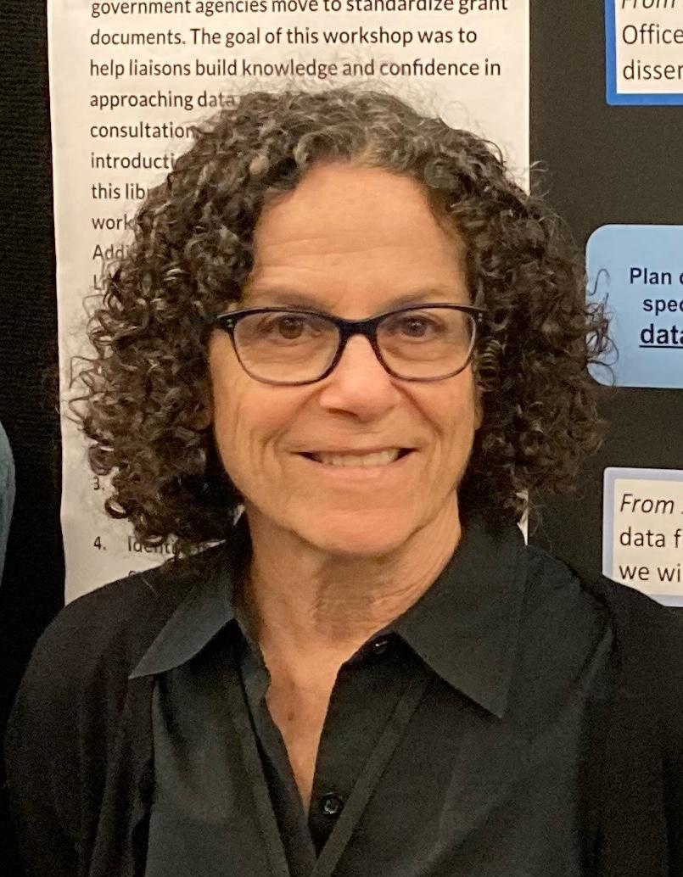
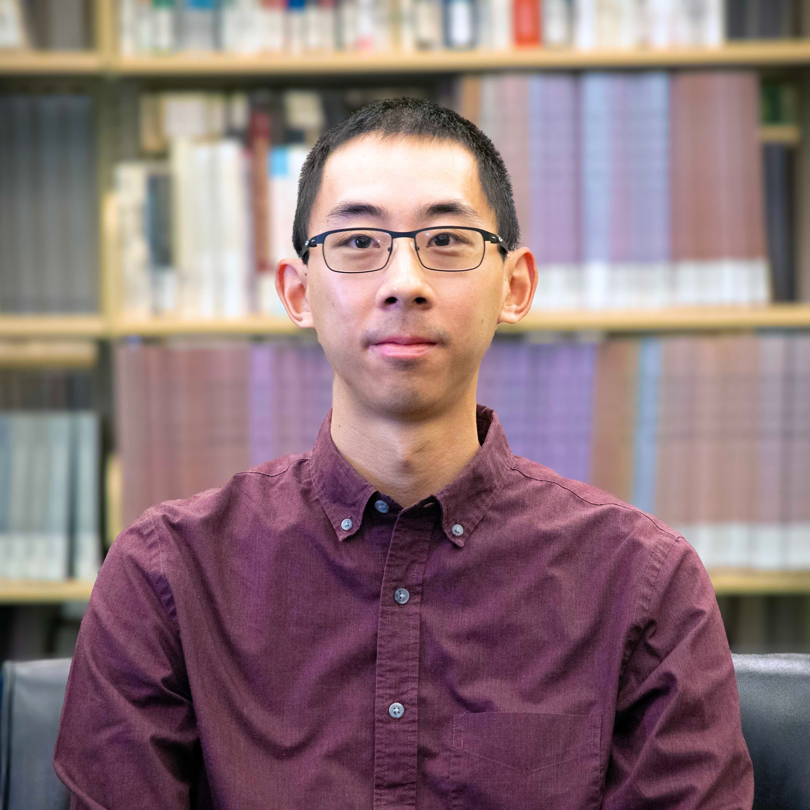
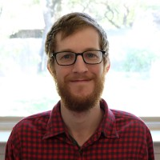
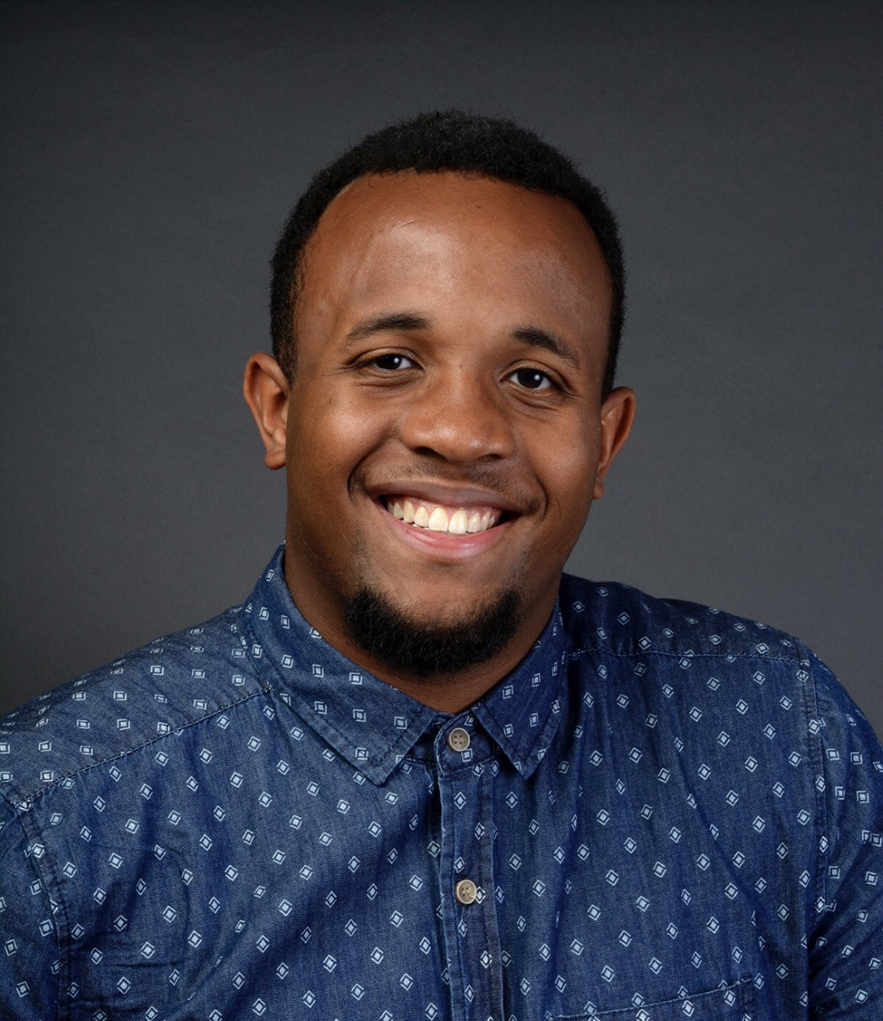
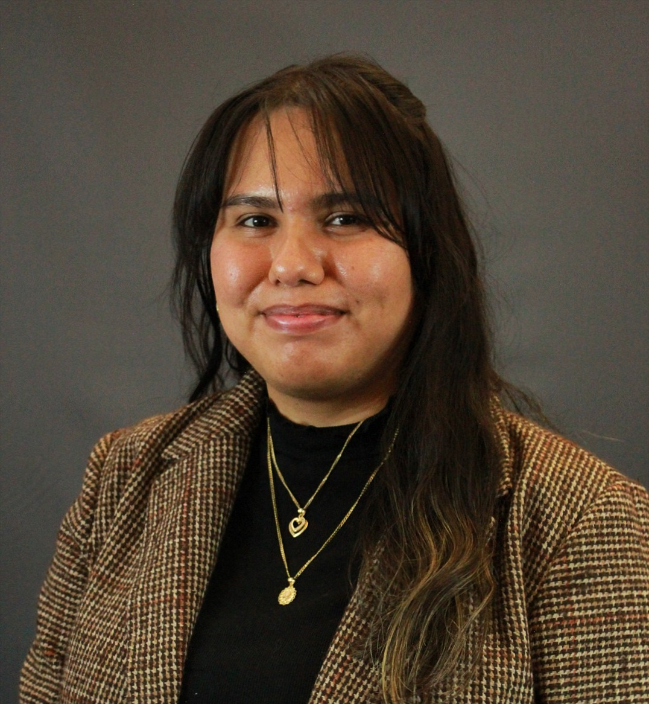
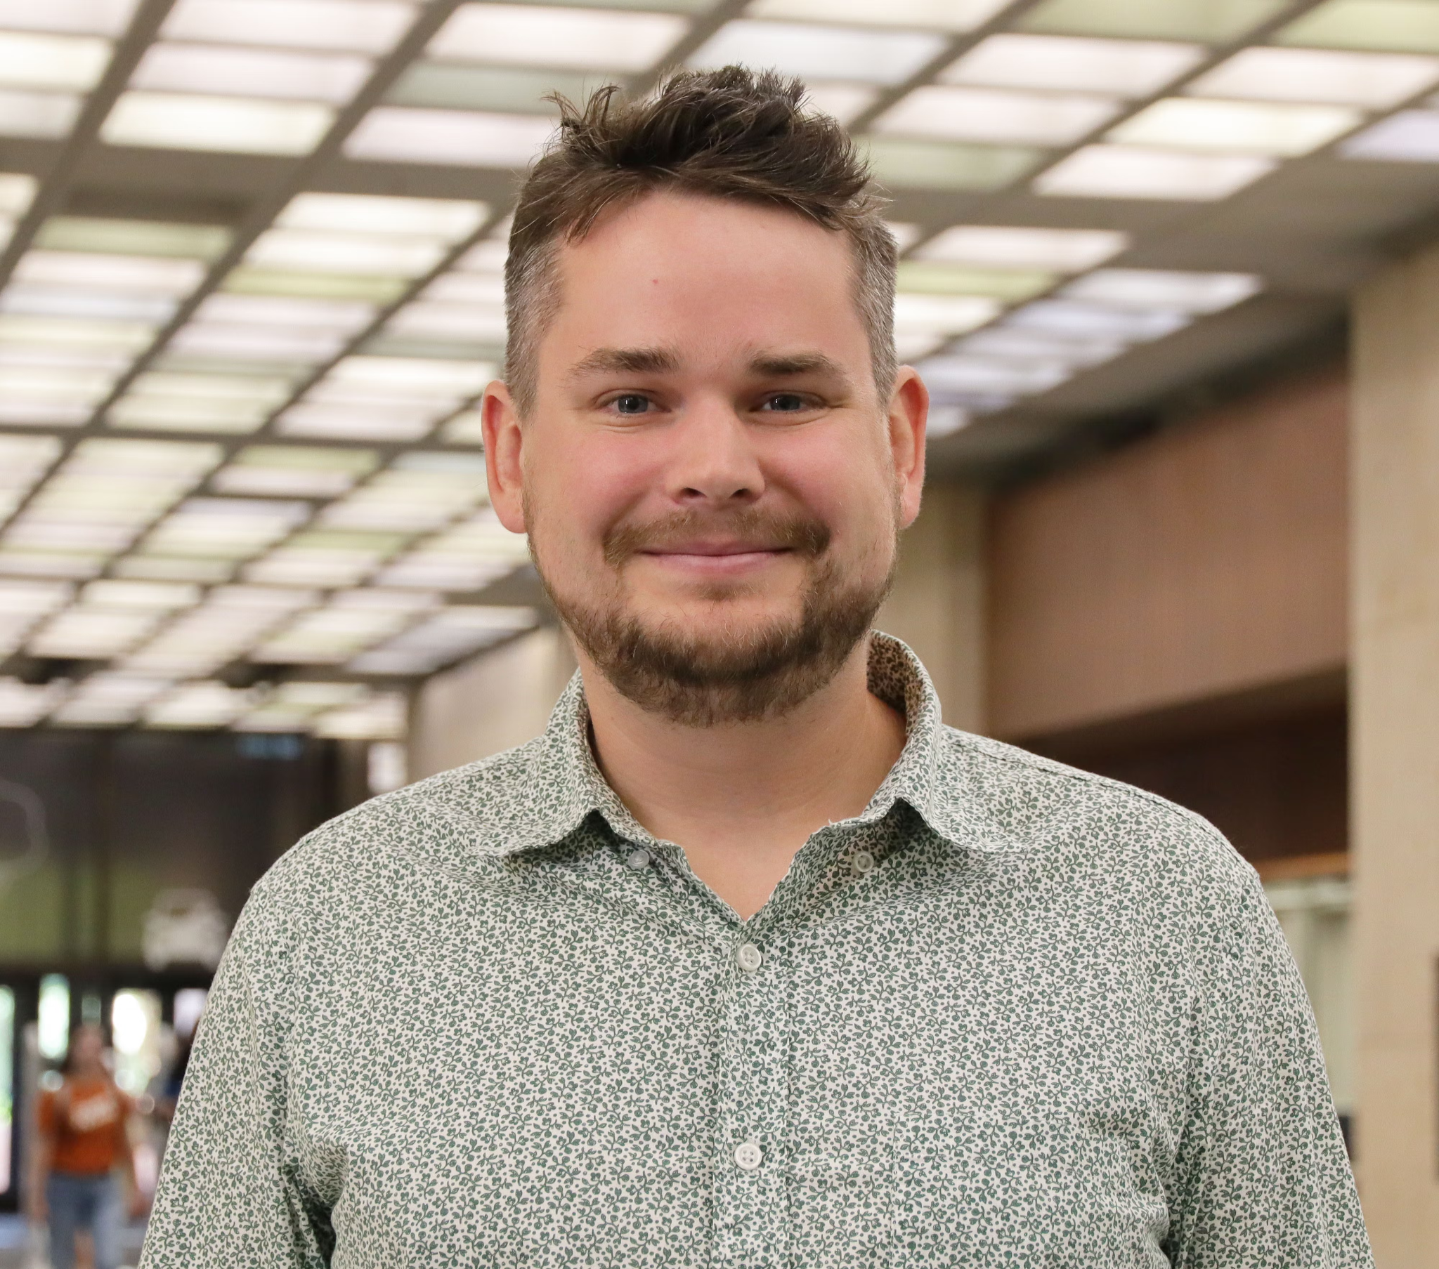
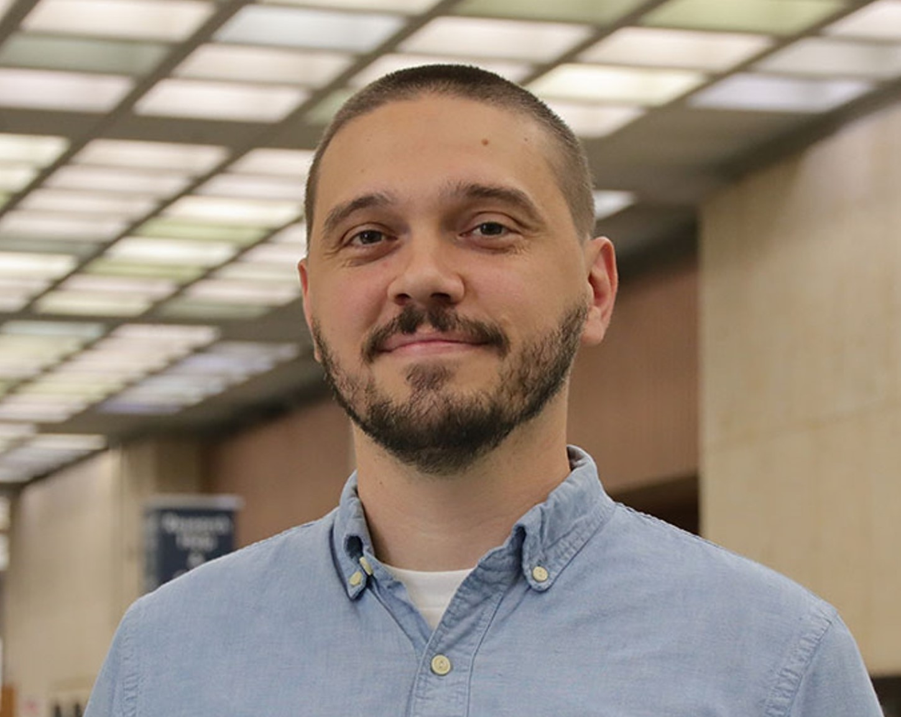
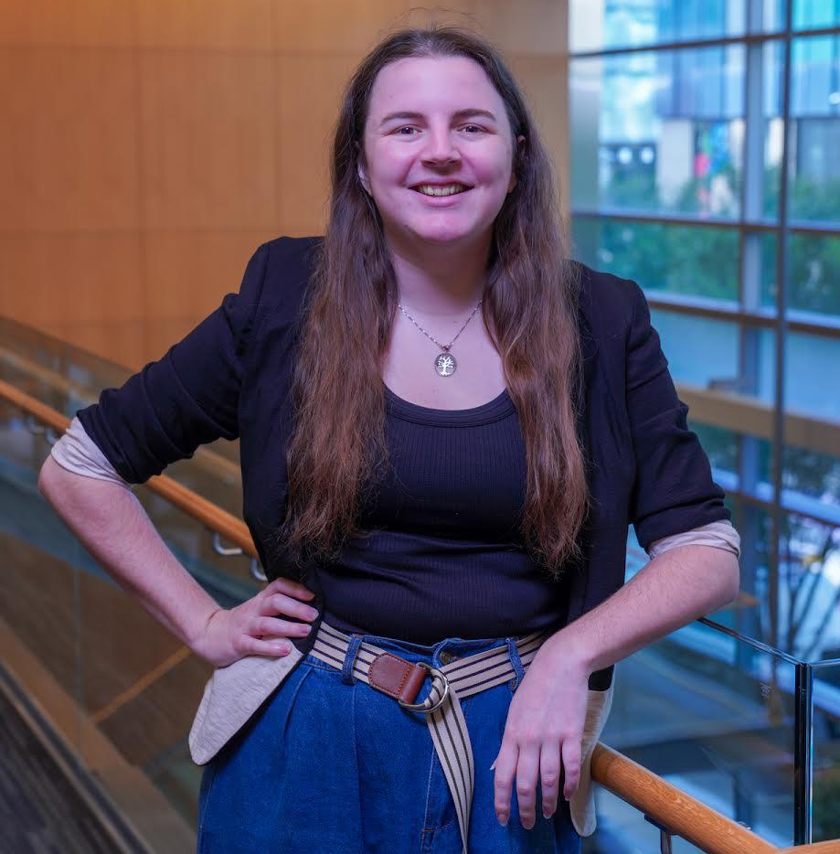
Instructors/Helpers
Meryl Brodsky
Bryan Gee
Ian Goodale
Jeremy Thompson
Communication & Information Librarian
Research Data Coordinator
European Studies and Linguistics Librarian
Digital Processing Archivist
Karina Sanchez
Alex Marden
Michael Shensky
Anna McGilvray
Digital Scholarship Librarian
GIS & Geospatial Data Coordinator
Head of Research Data Services
Physical and Computational Sciences Librarian
Notes:
Here are the helpers, who will also be instructors at some point in this workshop.
They are:
Alex Marden, GIS and Geospatial Coordinator
Anna McGilvray, Liaison Librarian for Physical & Computational Sciences
Bryan Gee, Open Research Coordinator for Data & Software
Ian Goodale, European Studies Librarian
Jeremy Thompson, Digital Processing Archivist
Karina Sanchez, Scholars Lab Librarian
Michael Shensky, Head of the Research Data Services Group

Slide 6
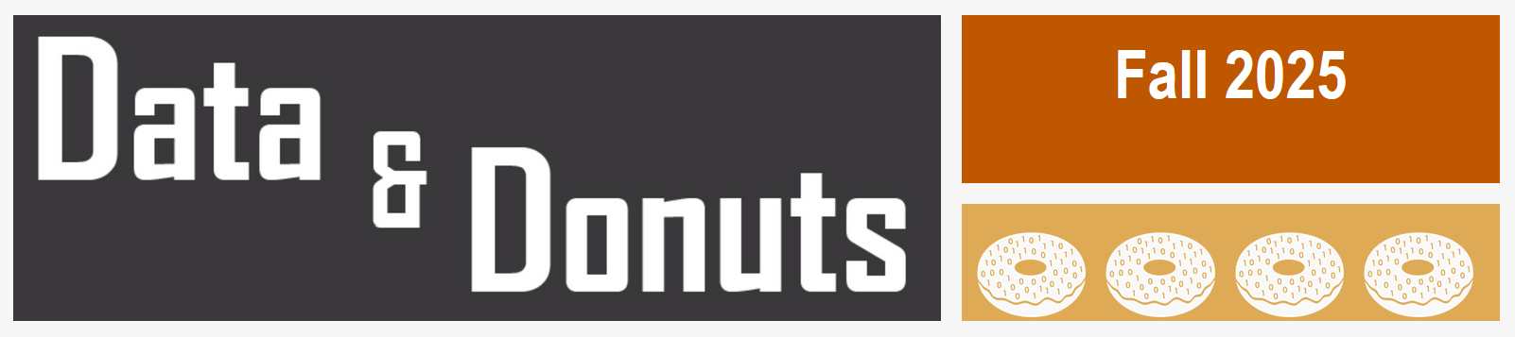
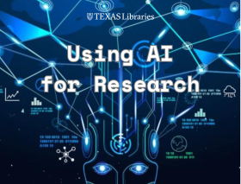
Upcoming Spring Workshops
Data & Donuts Workshop Series
What Workshops covering research data practices and software
When On the following dates: Jan. 30, Feb. 10, Feb. 11, Feb. 13, and Feb. 27
Time 12pm - 1:15pm
Where Zoom (all dates) / PCL Scholars Lab (select dates)
More info https://guides.lib.utexas.edu/data-and-donuts
Spring 2026
What Learn about AI tools for working with research code and data
When March 26, 2026 (Thursday): noon to 1 PM
Where Virtual
Using AI for Research
Library Events: https://lib.utexas.edu/events
Notes:
We’ve got other workshops and workshop series coming up in the Spring that may interest you.
Here are two.
Data & Donuts is a workshop series specifically related to data and software. These are a little over an hour and most are virtual or hybrid.
Using AI for Research series is on AI tools and how to use them for research purposes. The one highlighted here is on Using AI for working on research code and data.
To find library workshops, you can go to our home page, and search the Events section of the page. Most workshops require preregistration.

Slide 7
Code of Conduct
Use welcoming and inclusive language
Be respectful of different viewpoints and experiences
Gracefully accept constructive criticism
Focus on what is best for the community
Show courtesy and respect towards other community members
Contact any Helper or Instructor for assistance
Notes:
We also would like to introduce a code of conduct. Please:
Use welcoming and inclusive language
Be respectful of different viewpoints and experiences
Gracefully accept constructive criticism
Focus on what is best for all of us
Show courtesy and respect towards each other
Contact any of us who are instructors or helpers with any code of conduct concerns.

Slide 8
Goals - Introduce you to Python
Introduce the fundamental knowledge required to help you start using Python
Learn some of the vocabulary of Python, such as Data Types, Variables, Functions
Use Python without installing any software - this workshop will use Google Colab
Learn about resources to help you when you have a question or a problem
Notes:
Today our goal is introduce you to working with Python. We’ll go over basic vocabulary terms, and you’ll get a chance to actually do some programming using Google Colab, an Integrated Development Environment, and I’ll talk more about what that is in a moment.
Last, we’ll talk about how to get help outside of this workshop.

Slide 9
What is Python & why you should learn it
Open source programming language
Cross platform compatible (Windows, MacOS, & Linux)
Used in a variety of fields and disciplines
Large ecosystem of open source packages
Shared code can foster reproducibility
Notes:
Python is:
An open source programming language. This means that it’s free. It’s regularly updated, and there is a large user community. That user community comes in handy when you have questions or problems.
Python is the fastest-growing language in computer programming.
You should learn it because it is:
Compatible with Windows, Mac & Linux
It’s used in a variety of fields and disciplines
Flexible, in that it supports working with both numeric and text data
Also, there are many open source packages, which can help to automate certain functions. We’ll talk more about these later.
Since lots of people are using Python, it’s more useful to share Python code, which can foster reproducibility, which contributes to “open science.”

Slide 10
What you can do with Python
Text Mining
Web Scraping
Data Analysis
Data Visualization
Simulations & Modeling
Notes:
Python can be used for Text mining, that is looking for words or sentiments expressed in text once it is in a machine readable format. There is a good deal of humanities and social sciences research that uses this kind of analytical technique.
It’s used for Web Scraping, that is to pull data from websites.
It an be used for file management or analyzing data, as well as editing data, and visualizing data – that is creating graphs or charts.
Python is used in scientific fields like physics, chemistry, and bioinformatics for simulations and modeling.

Slide 11
Google Colab = Integrated Development Environment (IDE)
Examples
Benefits
Jupyter Notebooks
Visual Studio
PyCharm
Many others
Easier to write code
Improves code quality
Facilitates code sharing
Notes:
Google Colab is an integrated development environment, or IDE. An IDE is a software application that provides a user interface for software development.
It’s kind of like a shell that makes working with a programming language easier.
IDEs can enhance productivity and efficiency by offering features like code completion, syntax highlighting, and identifying where there are problems.
It can also help with project management by being able to download replicable code or upload files.
IDEs makes it easier to write code. They improves code quality because it catches typos and other errors, and sometimes make suggestions for fixes. Also, you can share work in an IDE and work with other people.

Slide 12

Google Colab
Colab is a free Google service that allows you to create and run Jupyter Notebooks in the cloud
You can use it to write Python code and text notes in compartmentalized cells within a notebook
Code cells can be run individually to allow for previewing outputs and troubleshooting issues
Notebooks are stored in Google Drive and can access other files in Google Drive
Notes:
Google Colab, is a free, cloud-based environment for writing and executing Python code. It's essentially a browser-based Jupyter Notebook environment, allowing users to combine code, text, images, and other media.
It works particularly well for education because it is browser-based, so no software installation is required.
Just so you know, you’ll have access to the Colab Notebooks and our slides, after the workshop.

Slide 13
Google Colab Notebook for today
https://bit.ly/3Y47JAJ
Notes:
Here’s a link to the Colab Notebook we’ll use for today’s workshop. Please open it up now.

Slide 14

Post programming
Where to find Help
Software installation
Image: Wong, Tommy. (July 5, 2006). https://www.flickr.com/photos/gracewong/183286968
Notes:
Date 5 July 2006
Source https://www.flickr.com/photos/gracewong/183286968
Author Tommy Wong
Permission: (Reusing this file) Free content licence.

Slide 15
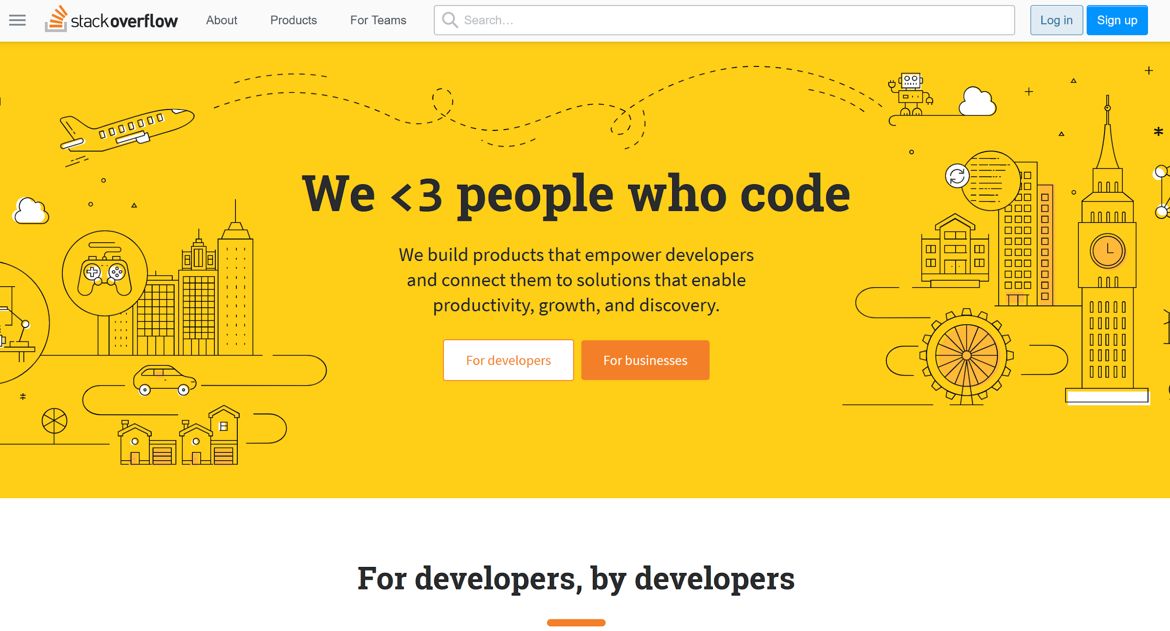
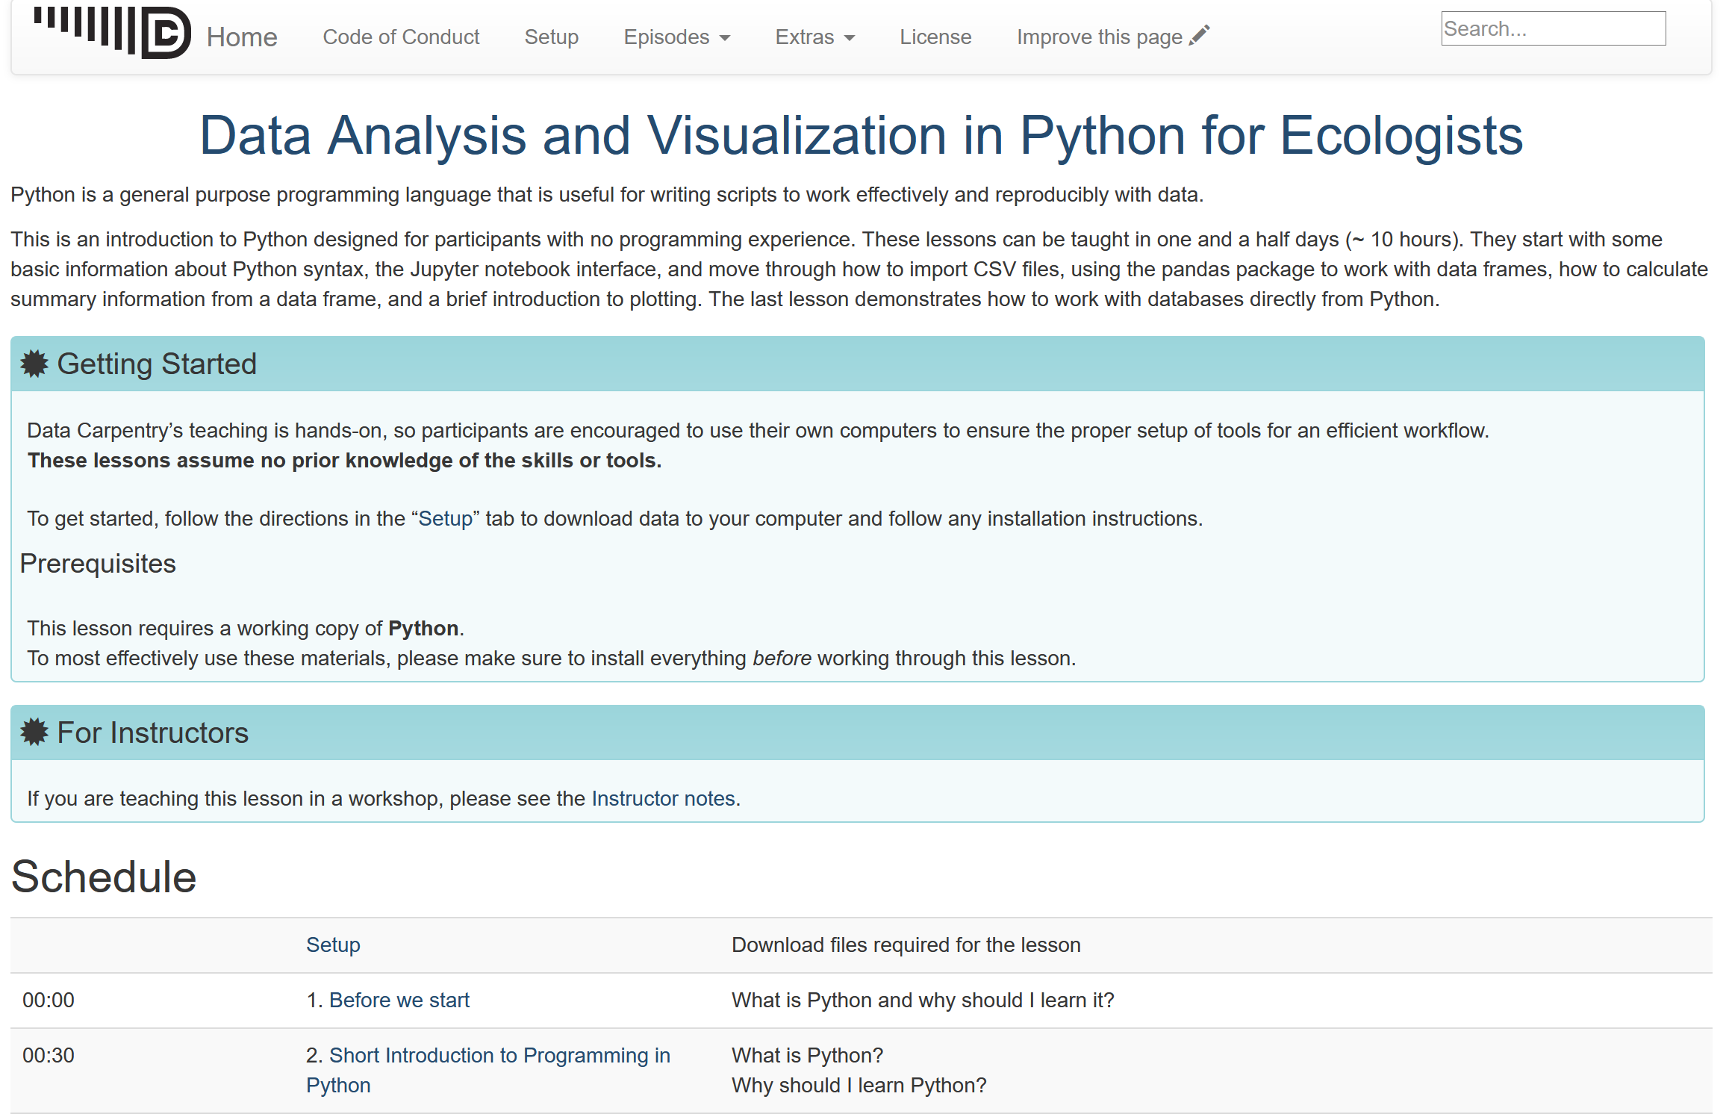
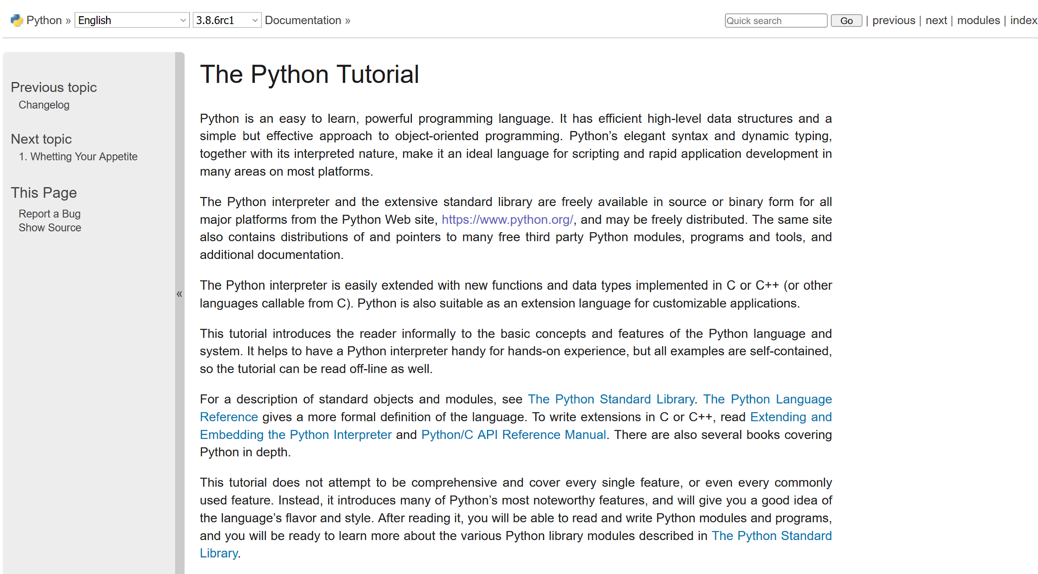
Helpful Resources
Stack Overflow (https://stackoverflow.com/)
Data Carpentry (https://datacarpentry.org/python-ecology-lesson/)
Python Documentation (https://docs.python.org/3/library/index.html)
Python Glossary
(https://www.w3schools.com/python/python_ref_glossary.asp)
Python Tutorial (https://docs.python.org/3/tutorial/index.html)
LinkedIn Learning (https://www.linkedin.com/learning/topics/python)
UT Statistics Short Courses (https://stat.utexas.edu/training/software-short-courses)
Google Colab: Intro to Python (https://colab.research.google.com/notebooks/intro.ipynb)
Notes:
Here are some extra resources that we have found to be helpful.
If you search for help when you’re having a question or problem, you can also use Google and thai will likely turn up responses from Reddit or Stack Overflow.

Slide 16
Thank you for coming!
Please fill out this brief survey https://bit.ly/4jg86C4
Questions?
Meryl Brodsky: Meryl.Brodsky@austin.utexas.edu
Karina Sánchez: karinasanchez@austin.utexas.edu
Please keep this slide for attribution
Notes:
Please fill out our assessment form linked here.

Slide 17
Software Installation*
*This is optional today
Install
Python
VS Code
Notes:
There are four different pieces of software that we will use during Thursday’s workshop, including Git and Github. Today we’re focusing on Python and Visual Studio Code (an IDE for Python)
If you like, you can install them now, or begin to install them, and we will be on hand to help you.
If you’ve had enough today, feel free to leave, and we’ll see you tomorrow.
You’ll have another opportunity to install this software at the end of tomorrow’s workshop.
Also, tomorrow, you may see or hear some of the same concepts that we discussed today. It’s not all the same, and tomorrow’s workshop will move on from the introductory material pretty quickly.

Slide 18
Installing Python - Windows
Python (https://www.python.org/downloads/)
Test
Make sure you can install new Python packages using the Command Prompt on Windows
Type the following command on your Windows: python -m pip install pandas
VSCode (https://code.visualstudio.com/download)
Test
Create a new file with the extension .py (to designate the file as a Python script)
Click the play/run button in the upper right corner of VSCode to run the script
Git (https://git-scm.com/downloads)
Github Desktop (https://desktop.github.com/download/)

Slide 19
Installing Python - Mac
Python (https://www.python.org/downloads/)
Test
Make sure you can install new Python packages using the Terminal (MacOS)
Type the following command on your Mac: python3 -m pip install pandas
VSCode (https://code.visualstudio.com/download)
Test
Create a new file with the extension .py (to designate the file as a Python script)
Click the play/run button in the upper right corner of VSCode to run the script
Git (https://git-scm.com/downloads)
Github Desktop (https://desktop.github.com/download/)

Slide 20
Troubleshooting Windows & Mac
Link to document here:
http://bit.ly/3J8adK2
Notes:
This is a troubleshooting document. You can use it if the standard downloading instructions don’t work. There are Windows and Mac sections.
You may have other issues, depending on whether your computer is owned by the university and you’re a staff person, or the age of your computer, or whether you’ve downloaded python and VS code before.

